Slide 1
KURNEL KRUSHERS
Prediction model made to identify which language a sentence is being spoken in.

Slide 2
Dataset-
https://tinyurl.com/yc699mek
The link for dataset is provided above and it contains 10 languages on which the model is trained and tested.
The dataset consists of simple phrases in each language which helps to create vocabulary of the language.

Slide 3
Technology and platform used
We have written the code in python and the platform used are Jupyter notebook and Google Colab.
We have used the CountVectorizer to convert text data into the numerical data so that model can understand the textual data.
For classification we have used the Multinomial Naïve Bayes model to get accurate classification of languages.
We’ve used it because MNB is a reliable and efficient algorithm for classification tasks, particularly when dealing with high-dimensional, text-based datasets.
Language Prediction.ipynb - Colaboratory (google.com)

Slide 4
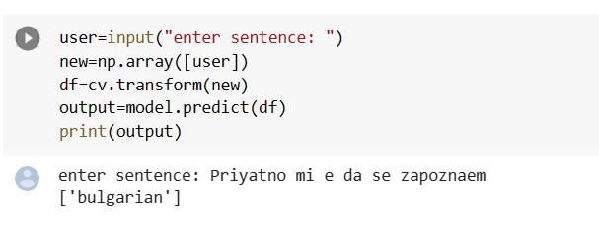
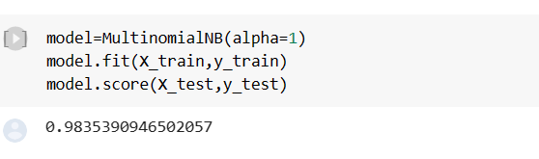
Outcome
We achieved an accuracy 0.9835 on the testing data and model was successfully able to identify the language on inputting a sentence.

Slide 5
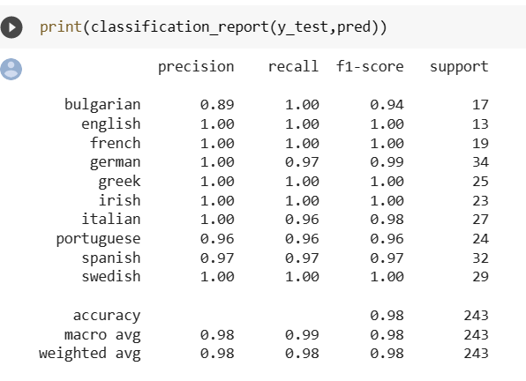
Classification Report

Slide 6
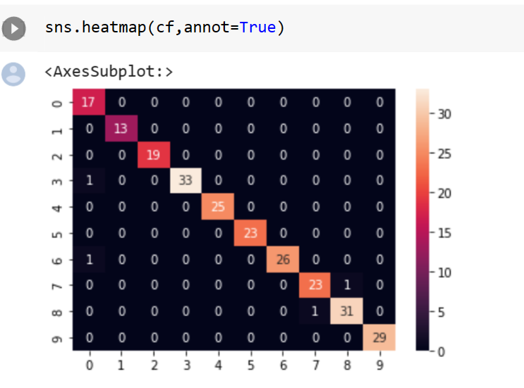
HeatMap

Slide 7
Conclusion
The language identification model can tell you which language a given sentence is written in, based on the unique features of that language, such as the use of specific characters or words.
The high accuracy of this model ensures that the language spoken can be easily identified.

